Slide 1
Using Networks to Investigate Semantics of Masculinities During the Neo-Assyrian Period
Ellie Bennett

Slide 2
Connell’s Framework
Connell, R.W., 1995. Masculinities. Polity Press, Cambridge.
Hegemonic
Seen as natural
Institutionalised
Complicit
Where most men fit
Try to achieve the ideal
Marginalised
Intersection with marginalised groups
Still trying to attain the 'ideal'
Subordinate
How NOT to be a man
Ideal in a society
Uphold the institutions maintaining the hegemonic model
Marginalised identity means this is manifested differently
Typically men demonstrating feminine traits
Not likely to be achievable by the majority of men
Women and non-binary figures can be along this spectrum,too

Slide 3
Masculinity
historical location
age and physique
sexual orientation
culture and subculture
class and occupation
religion and beliefs
ethnicity
geographical
status and lifestyle
education
Key aspect: fluidity – masculinities can change depending on different factors
Beynon, J., 2002. Masculinities and Culture. Open Universtiy Press, Buckingham, Philadelphia.

Slide 4
Computational Linguistics Method
Built on work by Semantic Domains team in Helsinki
  Alstola, T., Zaia, S., Sahala, A., Jauhiainen, H., Svärd, S., Lindén, K., 2019. AŠŠUR AND HIS FRIENDS: A STATISTICAL ANALYSIS OF NEO-ASSYRIAN TEXTS. Journal for Cuneiform Studies 159–180.
  Svärd, S., Jauhiainen, H., Sahala, A., Lindén, K., 2018. Semantic Domains in Akkadian Texts, in: Juloux, V.B., Gansell, A.R., di Ludovico, A. (Eds.), CyberResearch on the Ancient Near East and Neighboring Regions. Case Studies on Archaeological Data, Objects, Texts, and Digital Archiving, Digital Biblical Studies. Brill, Leiden; Boston, pp. 224–256.
Firthian approach
  Firth, J.R., 1968. A synopsis of linguistic theory, 1930-55, in: Selected Papers of J.R.Firth 1952-59. Longmans, London and Harlow, pp. 168–205.
  ‘You shall know a word by the company it keeps’ (p.173)
Data from ORACC (Code available on my Github page)
Ran Aleksi Sahala’s PMIzer programme
  506 ’target’ words
Put the results into Gephi to understand what is going on

Slide 5
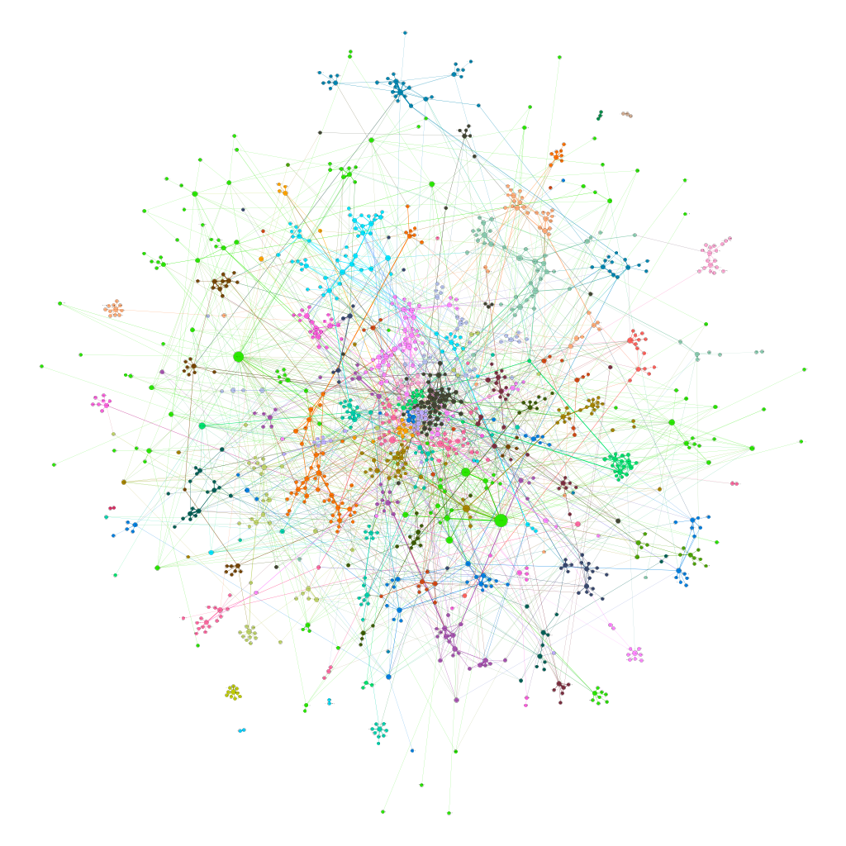
Nodes = dots
Edges = connecting lines
Communities = closely connected sub-groups

Slide 6

Image courtesy of: https://medialab.github.io/graph-recipes/#!/upload

Slide 7

Image courtesy of: https://medialab.github.io/graph-recipes/#!/upload

Slide 8
Highest concentration of nodes = religious, epithets, words about age
Image courtesy of: https://medialab.github.io/graph-recipes/#!/upload

Slide 9
Royal inscriptions epithets?
Image courtesy of: https://medialab.github.io/graph-recipes/#!/upload

Slide 10
Words to do with war (items and the actions involved)
Image courtesy of: https://medialab.github.io/graph-recipes/#!/upload

Slide 11
Archery Equipment
Hoffner, H.A., 1966. Symbols for Masculinity and Feminity: Their Use in Ancient near Eastern Sympathetic Magic Rituals. Journal of Biblical Literature 85, 326–334. https://doi.org/10.2307/3264246
  Psalm 127 4-5: Like arrows in the hand of a warrior are the children of one’s youth. Blessed is the man who fills his quiver with them!
  Suggested that archery equipment was a symbol of virility across ANE
    Visual representations e.g. palace reliefs: appear as symbol of the king and in warfare contexts
Focussed on words:
qaštu[bow] | ūṣu[arrow(head)]
sasinnu[bowyer] | šiltāhu[arrow]
tilpānu[bow] | išpatu[quiver]
mulmullu[arrow]

Slide 12
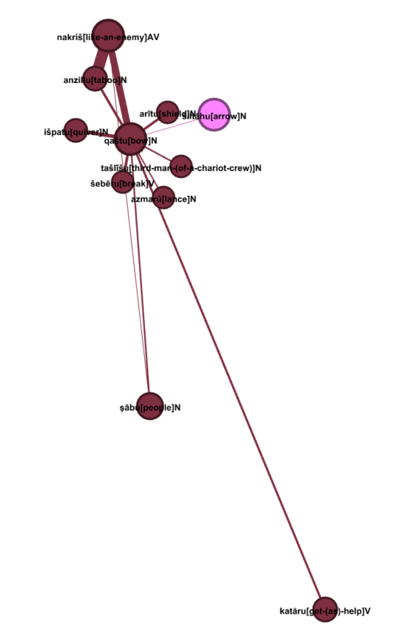
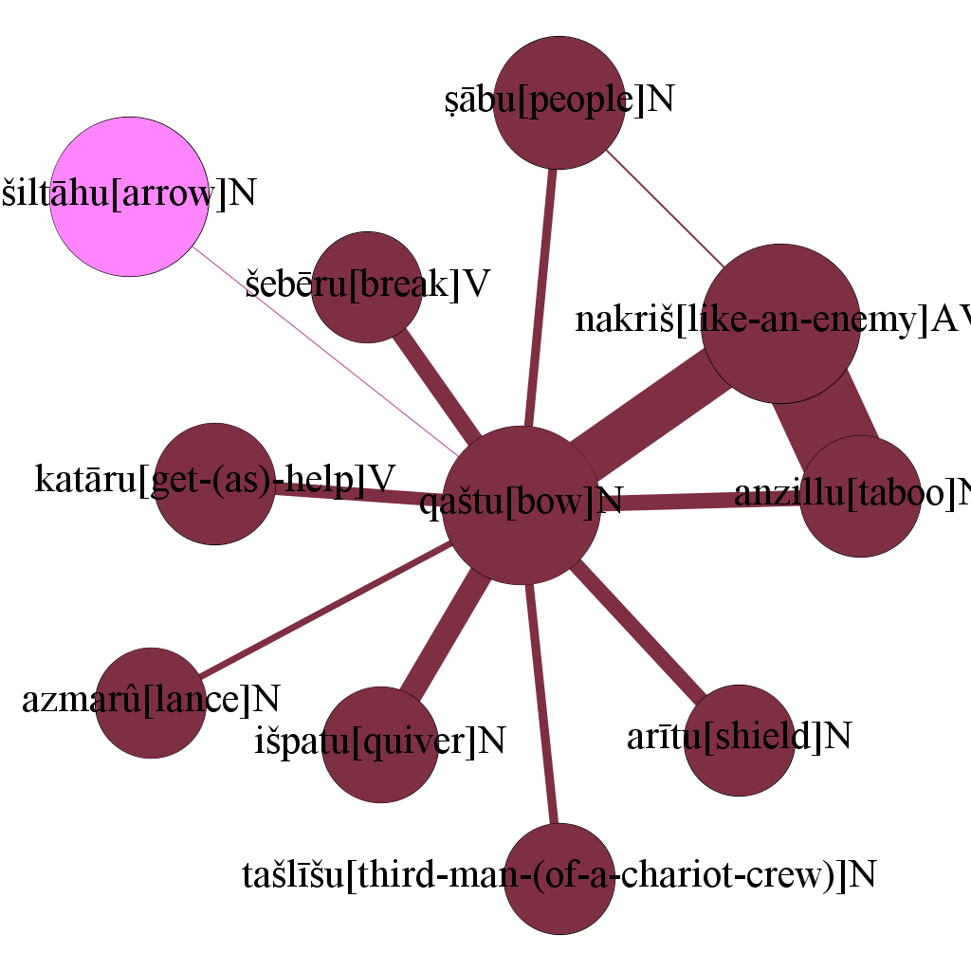
Ego Network: qaštu (bow)

Slide 13
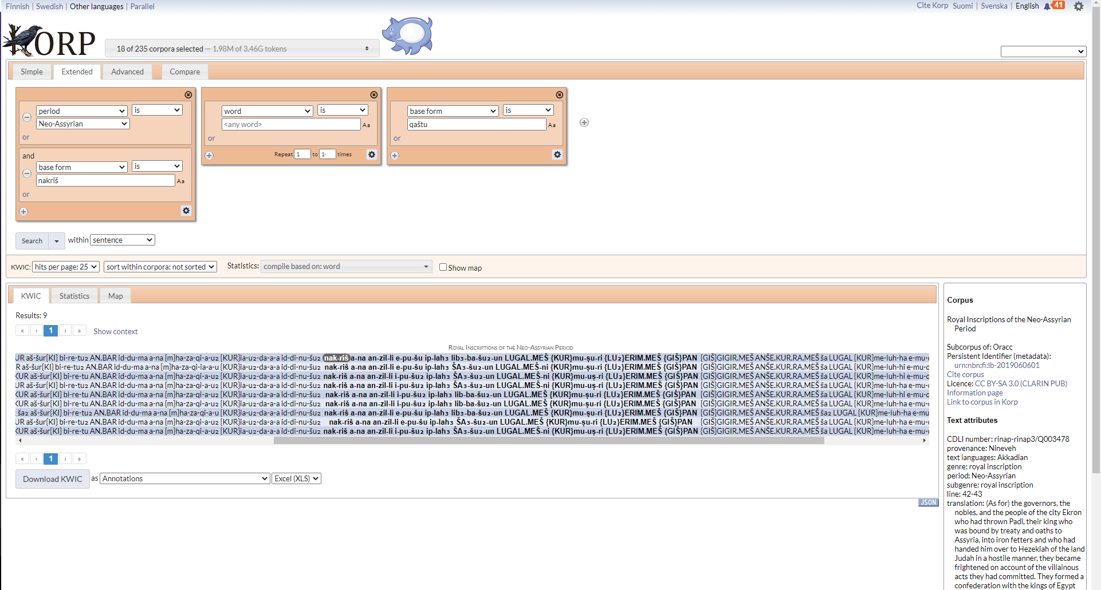
KORP

Slide 14
Qaštu (bow) and ṣābu (people)
KORP results for ṣābu and qaštu
KORP results for qaštu and ṣābu

Slide 15
Qaštu (bow) and šebēru (to break)
KORP results for šebēru and qaštu
KORP results for qaštu and šebēru

Slide 16
Qaštu (bow) and išpatu (quiver)
KORP results for išpatu and qaštu
KORP results for qaštu and išpatu

Slide 17
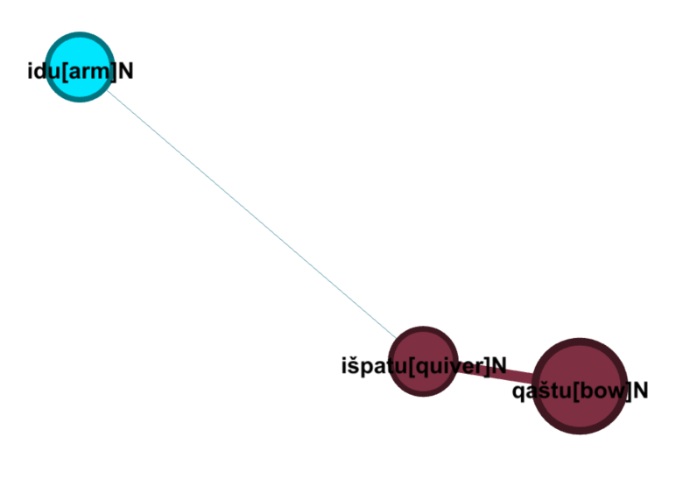
Ego Network: išpatu (quiver)

Slide 18
išpatu (quiver) and idu (arm)
KORP results for išpatu and idu
KORP results for idu and išpatu

Slide 19
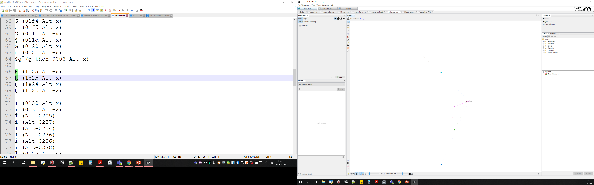
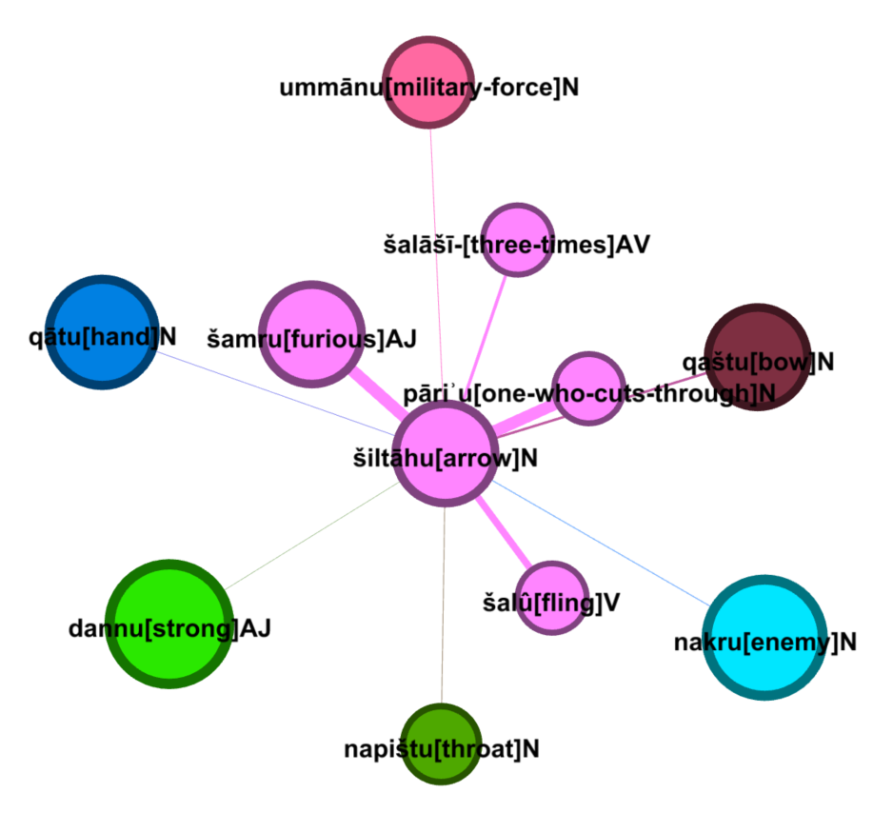
Ego Network: šiltāḫu (arrow)

Slide 20
šiltāḫu (arrow) and šamru (furious)
KORP search: šiltāḫu and šamru
KORP search: šamru and šiltāḫu

Slide 21
Šiltāḫu (arrow) and šalāšī (three-times)
KORP search: šiltāḫu and šalāšī
KORP search: šalāšī and šiltāḫu

Slide 22
šiltāḫu (arrow) and qātu (hand)
KORP search: šiltāḫu and qātu
KORP search: qātu and šiltāḫu

Slide 23
Šiltāḫu (arrow) and napištu (throat)
KORP search: šiltāḫu and napištu
KORP search: napištu and šiltāḫu

Slide 24
Hegemonic
Close ties with warfare and martial prowess
The arrow was seen as a killing machine, and the ideal scenario was using as few as possible
With this connection to death and killing, I find it strange that there woul be a second connotation of virility or fertility – the bringing of new life
Clear connection to several divinities
  Ishtar, Ninurta, Marduk, Ashur, Sebetti

Slide 25
Non-hegemonic
Use in curse formula of oaths and treaties
Gods breaking bow in warfare
  Effectively make those holding the bow useless on the field and ready to be slaughtered
Other formulation identified: ’turning the bow in your hand’
  Not breaking the bow, but shows incompetence at using a bow
  connection to epithets used for foreign kings to show they were not capable of worshipping the gods correctly

Slide 26
Conclusions
Computational linguistic and visualisation method allowed for faster and easier analysis
Overall disproves Hoffner’s hypothesis that the quiver and arrows were symbols of male virility, at least in the Neo-Assyrian period.
Hegemonic masculinity and archery equipment: used to illustrate martial prowess and the connection of the man with the gods
Non-hegemonic masculinity and archery equipment: used to show how the man was at the mercy of the Neo-Assyrian army or king, and incompetence
Next step: see if this correlates in texts not present in ORACC, as well as visual representations of archery equipment

Slide 27
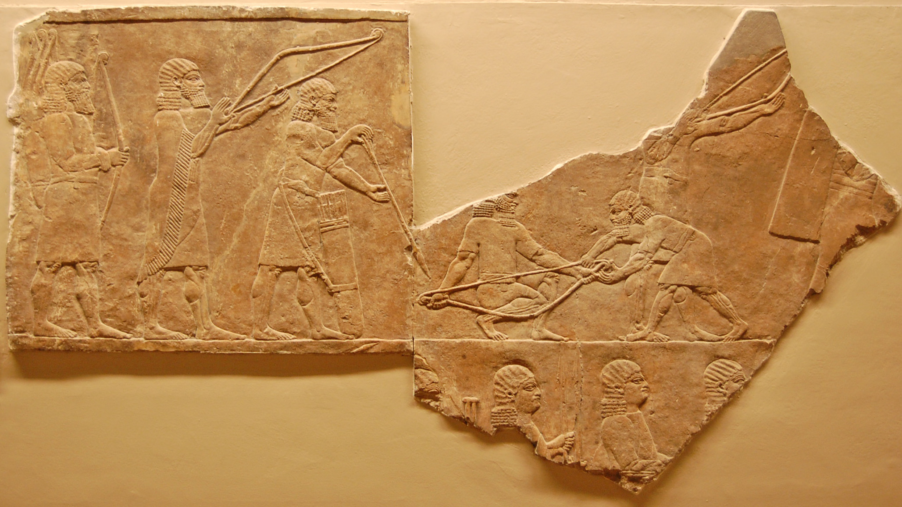
Thank You For listening
© The Trustees of the British Museum.
Email: eleanor.bennett@helsinki.fi
Twitter: @Bennett91E

