Slide 1
Having an Online Presence as a Researcher
Ellie Bennett
@Bennett91E
eleanor.bennett@helsinki.fi

Slide 2


Communicating with peers
E-mail
  Directly emailing colleagues
  Email lists like Agade
  Email signatures
    social media info and latest research
Personal websites
academia.edu
  Problem with paywalls to the best parts (finding out who’s seen your page or downloaded items from your profile)
  https://helsinki.academia.edu/EllieBennett
Alternative: ResearchGate, but based for those who aren’t in the Humanities
  Has option to ask questions and form more of a community

Slide 3

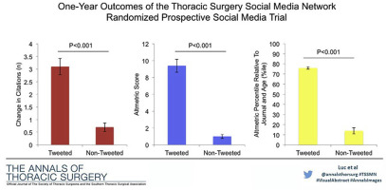
Twitter
Tweeting your article will increase the likelihood of getting more citations - study of 1-year impact after tweeting.
Most likely to access people not already in your network.

Slide 4
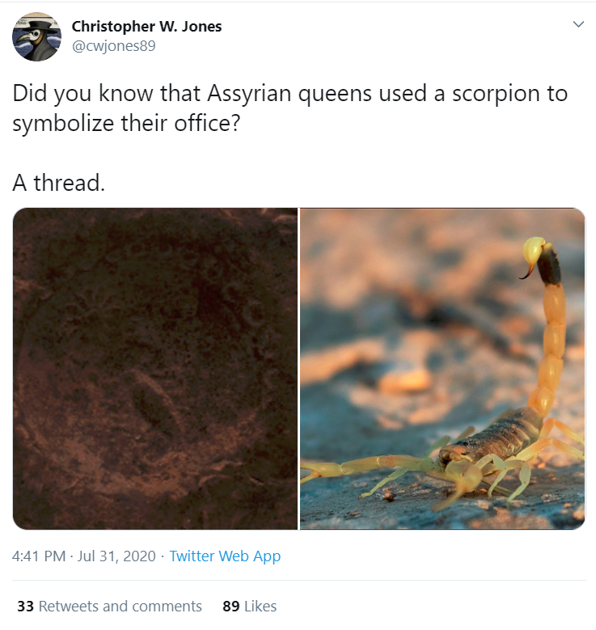
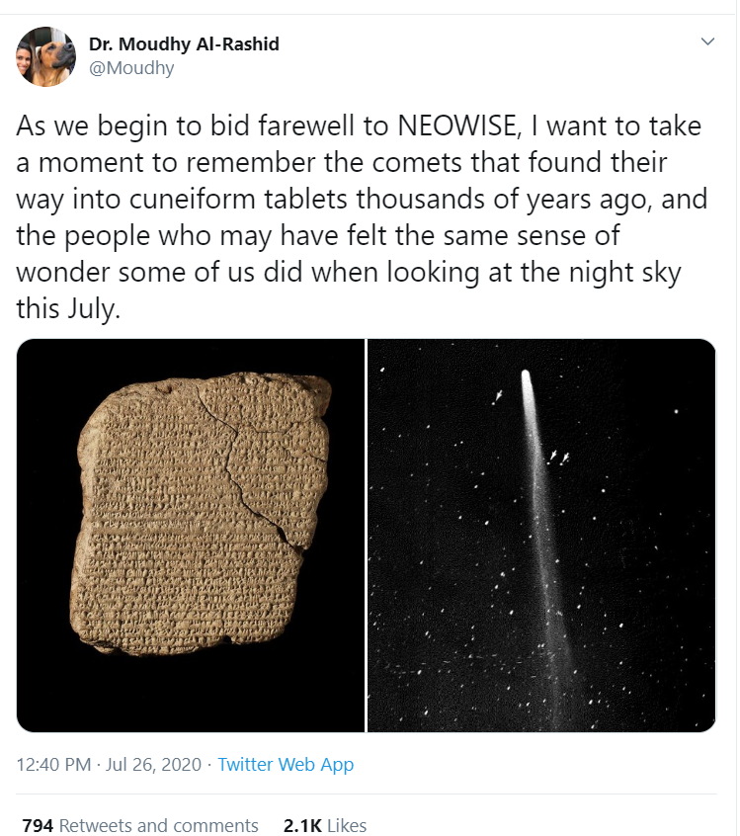
https://twitter.com/Moudhy/status/1287321843196731392?s=20
https://twitter.com/cwjones89/status/1289194451525459968?s=20

Slide 5
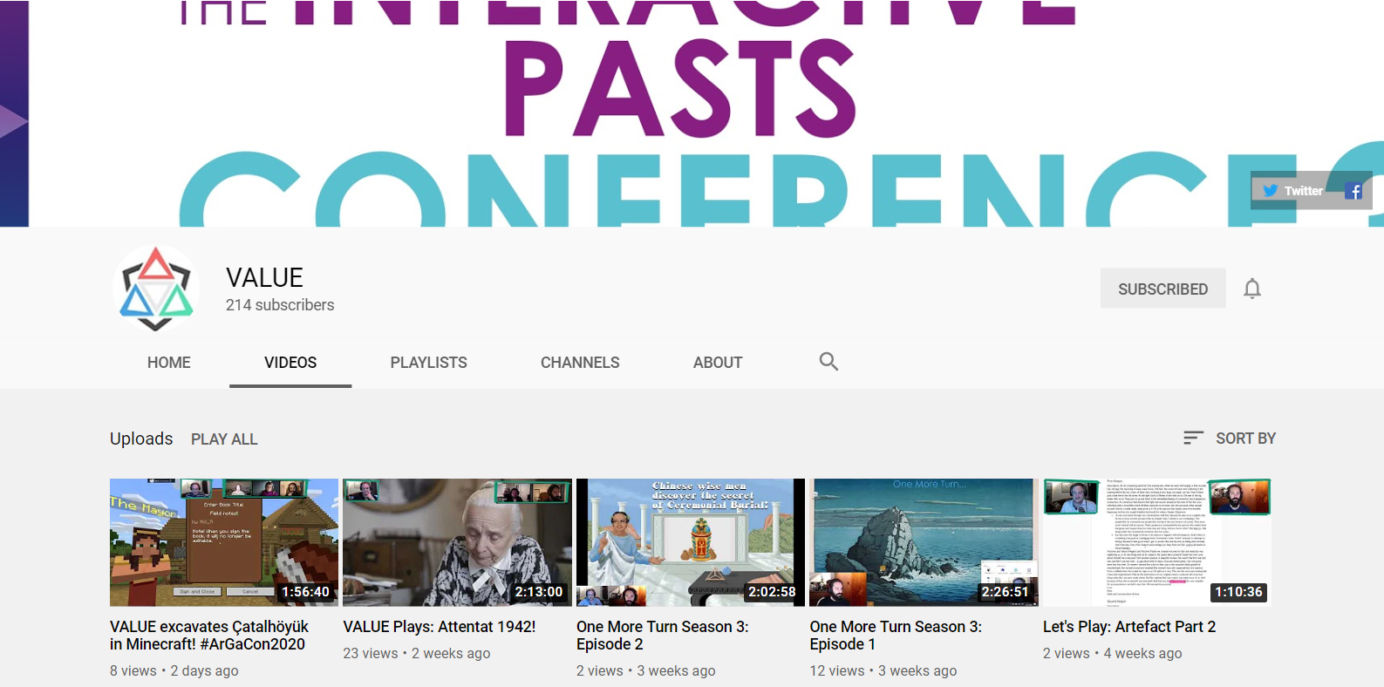
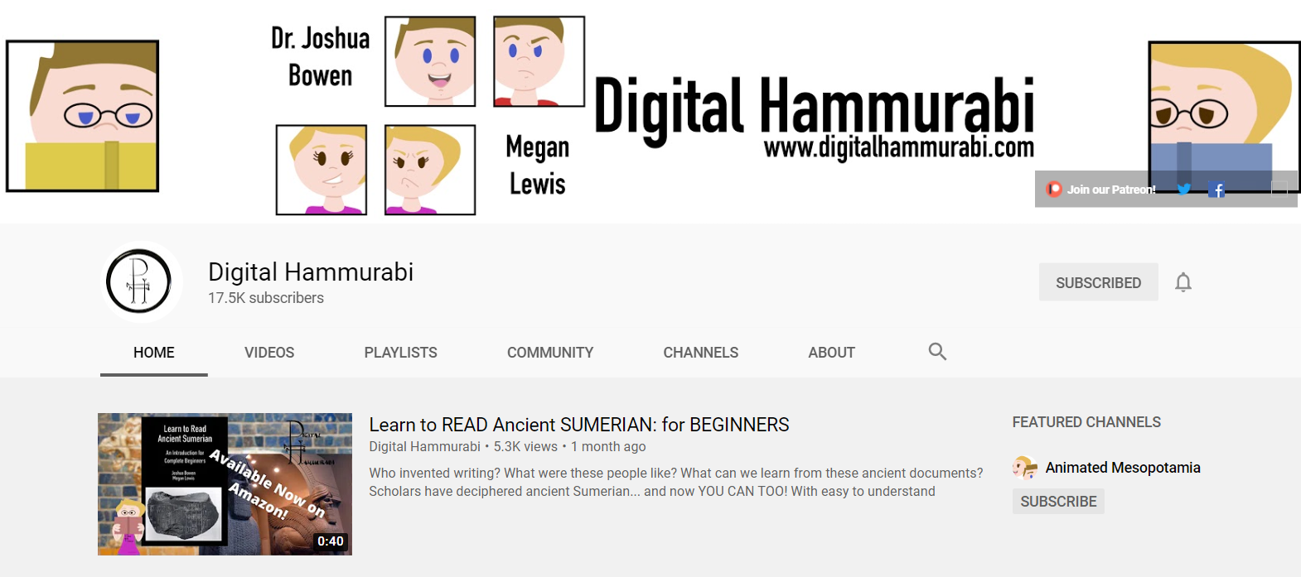

Youtube channels
https://flamma.helsinki.fi/fi/group/viestinta-ja-tapahtumat/videosi-yliopiston-youtube-kanavalle
https://authorservices.taylorandfrancis.com/video-abstracts/

Slide 6

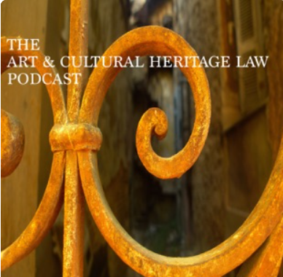

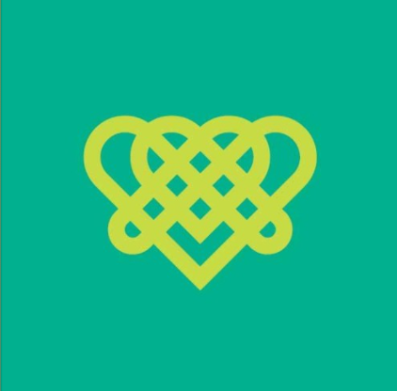
Podcasts
https://flamma.helsinki.fi/fi/group/viestinta-ja-tapahtumat/podcastit
https://blogs.helsinki.fi/podcourse/

Slide 7
How do I build a research profile?
Think about how you want to use the platform
  Is it a platform in use by a lot of your colleagues?
    (if you were to post something controversial, what is the likelihood of a potential employer seeing it?)
  Is it worth having a personal and work account on the platform?
Think about how regularly you can commit to posting something/create content
  This shouldn’t be a second job!
Think about your audience
  This can change over time
  Do you want to connect with colleagues?
  Do you want to educate the public?
Hashtags!!
Make sure all your profiles are linked on all the platforms (where possible)
Use social media to create a support network during your PhD

Slide 8
What can I post?
Career developments
Conference presentations
Participation/organisation of workshops
Any teaching opportunities
Article publications (esp. If doing an article-based dissertation!)
Collaborations
Daily updates of what your research looks like day-to-day
Outlet for PhD frustrations
Small updates about your research (but you decide on the detail you go into, as this runs the risk of putting research that isn’t ready into the world)
Talk to other people!
  Engage in conversations on the platform - remember to be calm, and respectful. If you don’t understand something in a post, as the poster to explain in more detail.

Slide 9
Twitter policies about images:
Fair Use Policy (I think this will be the most useful link, as it allows you to post images which are in the public interest. More sensitive images should only be published after contacting the owners)
Some more useful policy links:
Twitter’s General Policy page (if a question hasn’t been answered, it’s worth having a look through this)
Sensitive media policy (useful if you have images of hateful symbols)
Parody, newsfeed, and commentary policy
Trademark policy (about the usage of logos)

Slide 10
Flamma page for trolling or harrasment:
https://flamma.helsinki.fi/en/group/ajankohtaista/news/-/uutinen/researchers-teachers-and-experts--you-are-not-alone-in-difficult-social-media-situations/9526564
If the link doesn’t work, type ’troll’ into the Flamma search bar, and it should be the second result on the page.
It provides a useful ’actions to take’ if you do encounter harrasment or trolling online, as well as the different options open to you.
University of Helsinki Social Media Guidelines for Personal Accounts

